Slide 1
Tackling operational time-to-market decelerators in AI/ML projects
Andreea M. Munteanu - Product Manager, Canonical
Adrian G. Matei - Product Manager, Canonical

Slide 2
Optimised routing in telco
800+
300+
2M
Weekly experiments
GPUs from different silicon vendors
Devices across the globe benefit from this solution

Slide 3


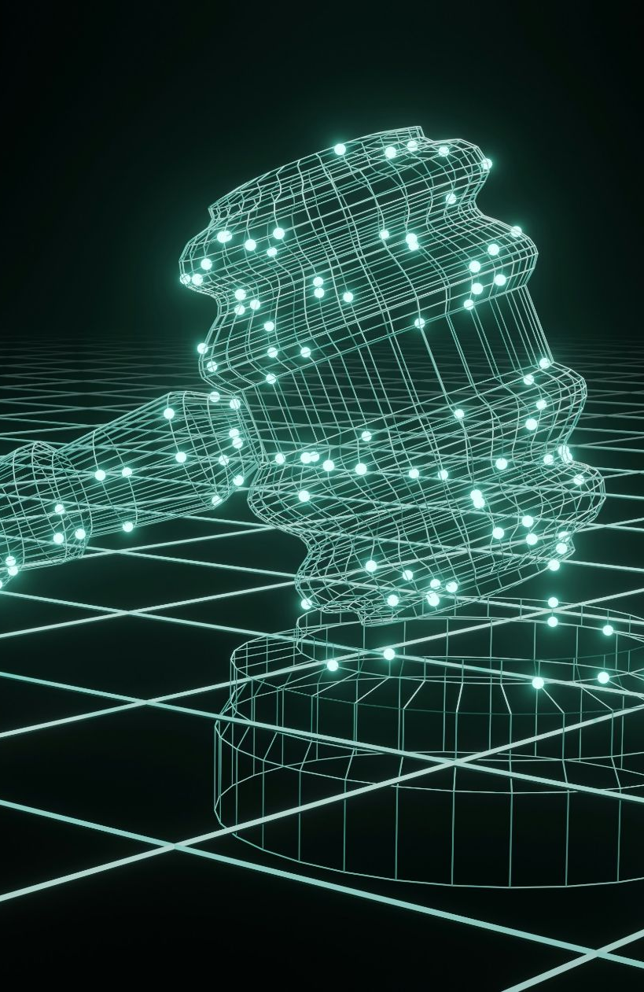



Key AI market challenges
Use case definition
Tooling fragmentation
Security and compliance
Lack of ML architecture standards
Talent gap
Slow time to market
Building a business case
Tools fragmentation
Notes:
Innovation is exciting, but the challenges are significant.
Getting started is often overwhelming: you need to understand your the use cases and identify which one will bring ROI
Every day, there is a new tool popping up on the market. The landscape is disconnected, leading to incompatible tools and many vendors needed for the support.
The ML infrastructure often includes tools, frameworks and libraries that are outdated or contain a lot of vulnerabilities. It puts at risk the data used for model training, but also the other created artefacts.
Also, depending on the environment, the costs associated with the AI projects are unpredictable. It leads to difficulties in budgeting.
And yet, since everyone is looking nowadays to build an AI strategy, there is a skillgap that often slows down the entire process.

Slide 4
The operational issue
Idea
Time to market
Revenue
Design
Wireframes
Coding
Testing
Marketing
Operationally vulnerable
Notes:
Slide 2: Time to market definition - key message: Time to market is essential because it allows you to get to the market before competitors and increases sales, profit, and market share

Slide 5
If y=x
Problem
Operational detractors to time-to-market
Solution
Operational Excellence
Notes:
Slide 3: Time to market breakdown - key message: Good TTM requires a combination of skill, agility, efficiency, and operational excellence (which is often overlooked)

Slide 6
Operational excellence in AI
Optimised operations to accelerate project delivery
Secure and compliant open source software
Operational excellence in AI
Scalable solution to achieve cost efficency
Reliable tooling across all layers of the stack
Notes:
Slide 4: Operational Excellence in AI - key message: OE in AI is a combination of practices that increase the efficiency of each component of the stack to maximize reliability and scalability

Slide 7
Why is this relevant?
Your company: |  | Unstable environments Delayed project delivery Security breaches Inaccurate data & conclusions
Your data: |  | Inconsistent upgrades Unauthorized user access Leakage/theft
Your processes: |  | Highly manual, unnecessary processes Unintegrated tools
Notes:
Slide 5: Why is this relevant? - key message: improper operations have consequences on models, processes, and businesses overall

Slide 8
Breaking down operations
BAU
Planned events
Unplanned events
Monitoring
Upgrades & patches
Incident recovery protocols
Alerting
Infrastructure scaling
Bug fixing
Scaling within limits
Migration
Troubleshooting
Notes:
Slide 6: What do operations look like? Key message: operations for AI are practices that apply to three categories of events: BAU, planned, and unplanned incidents.

Slide 9
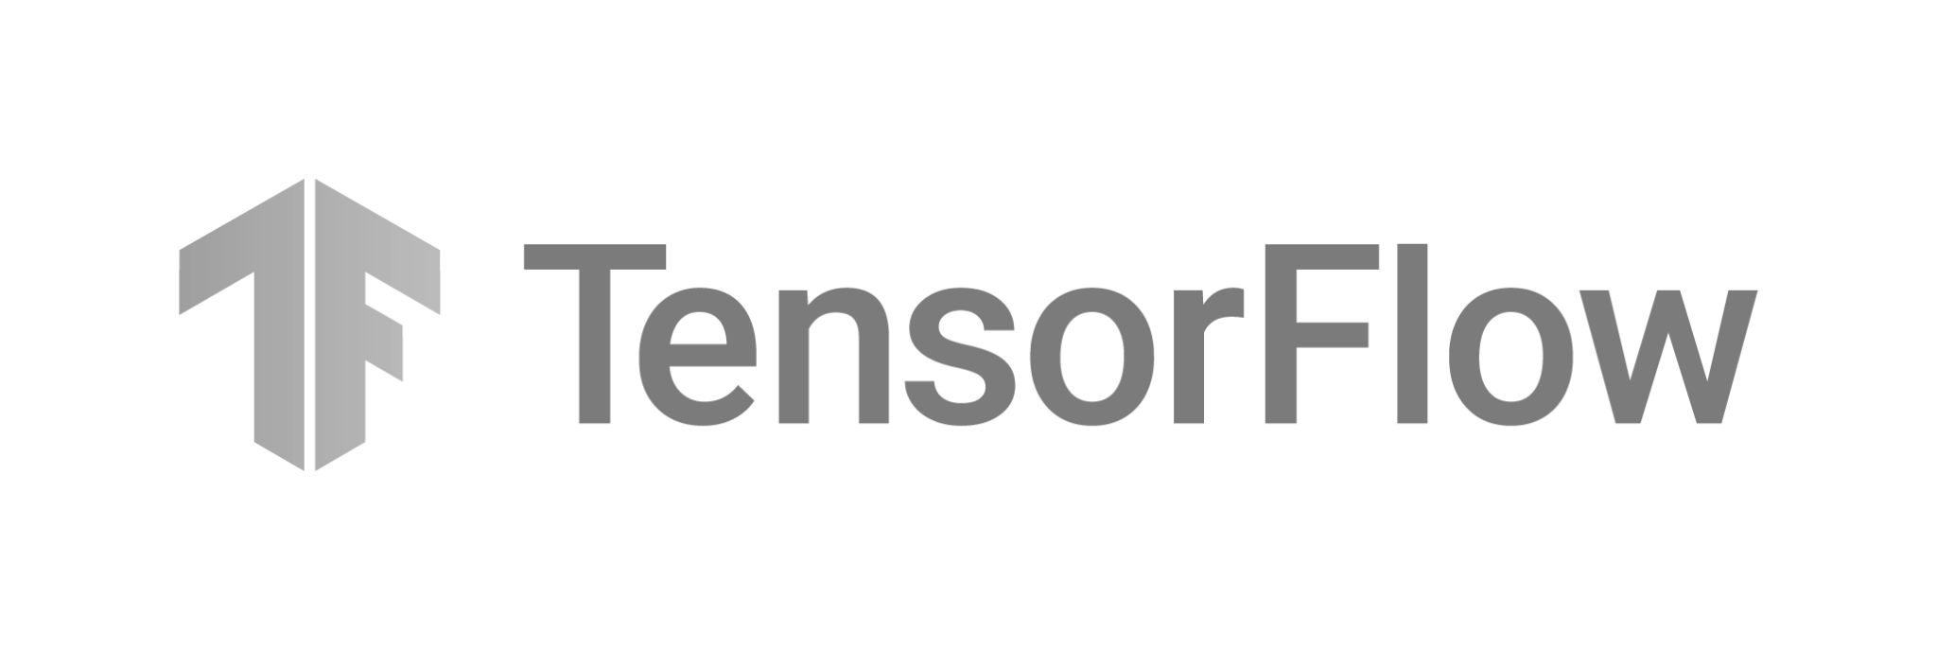


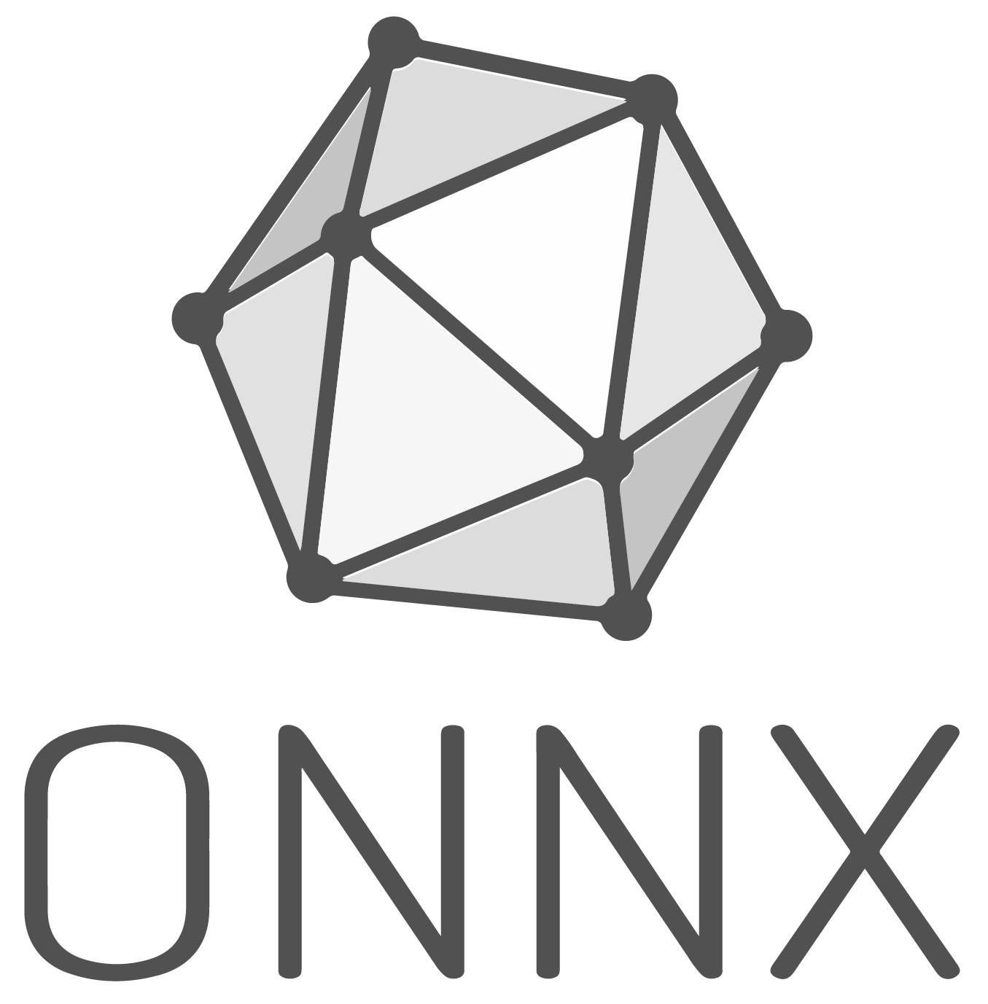





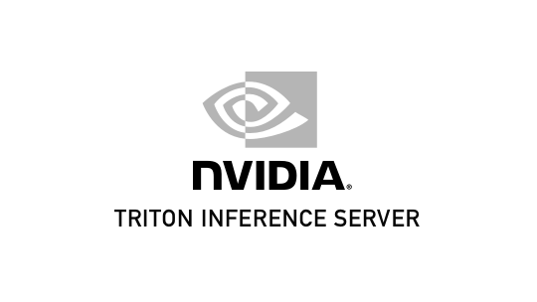


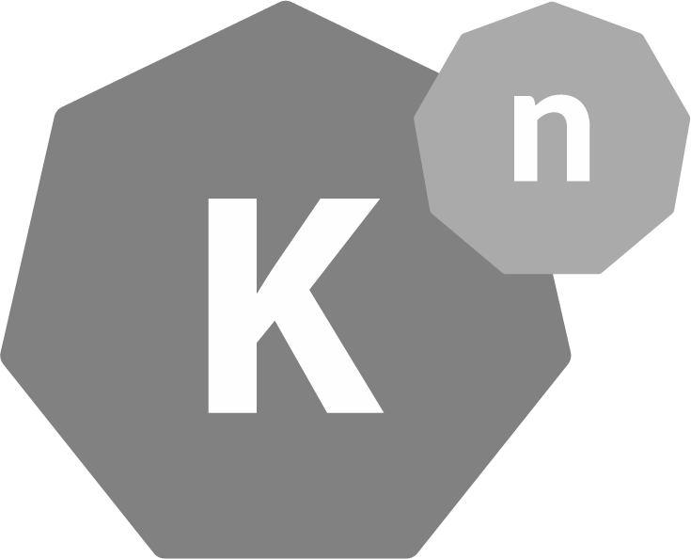


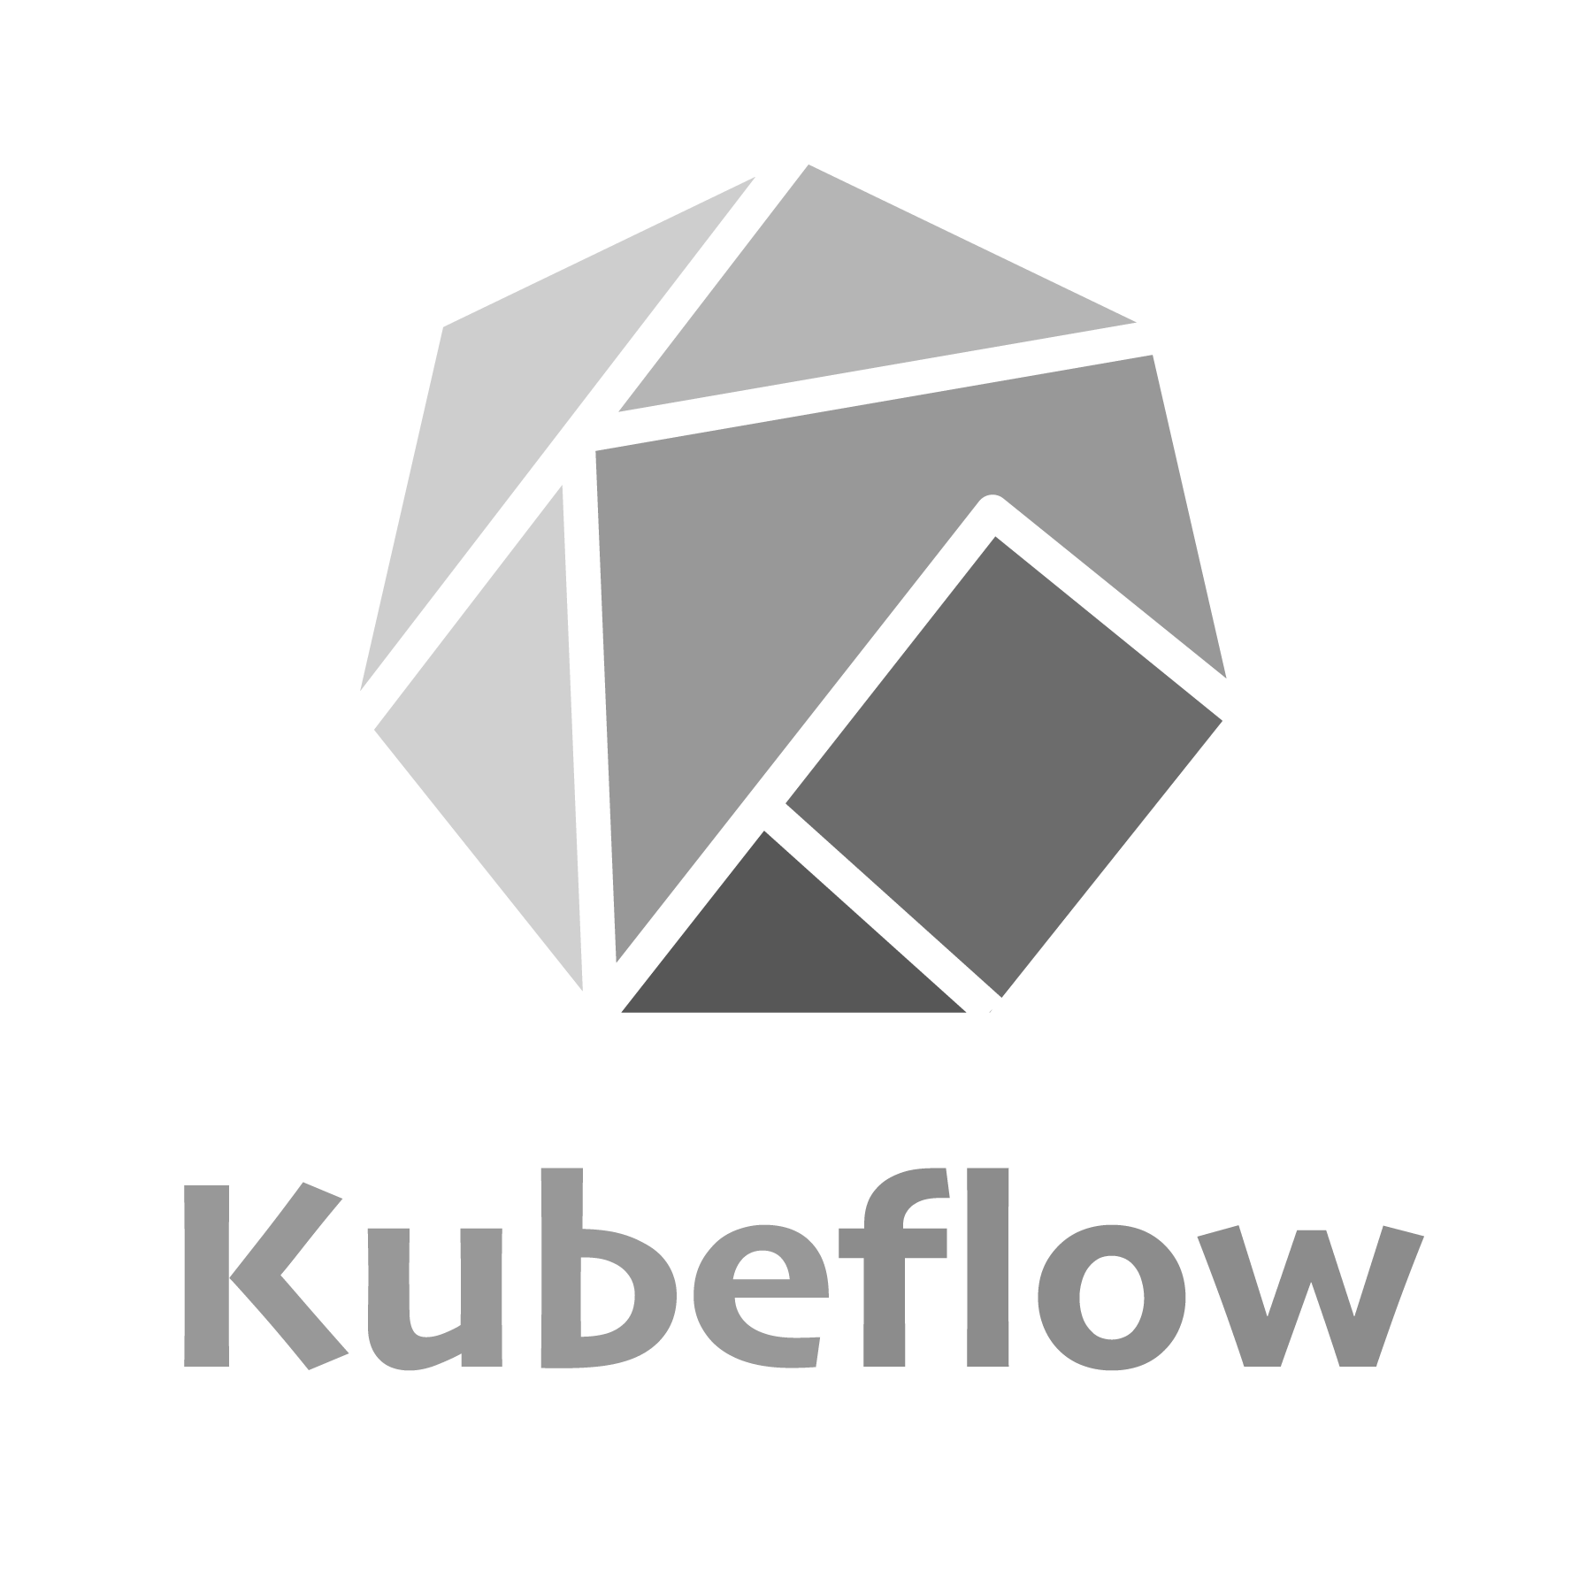

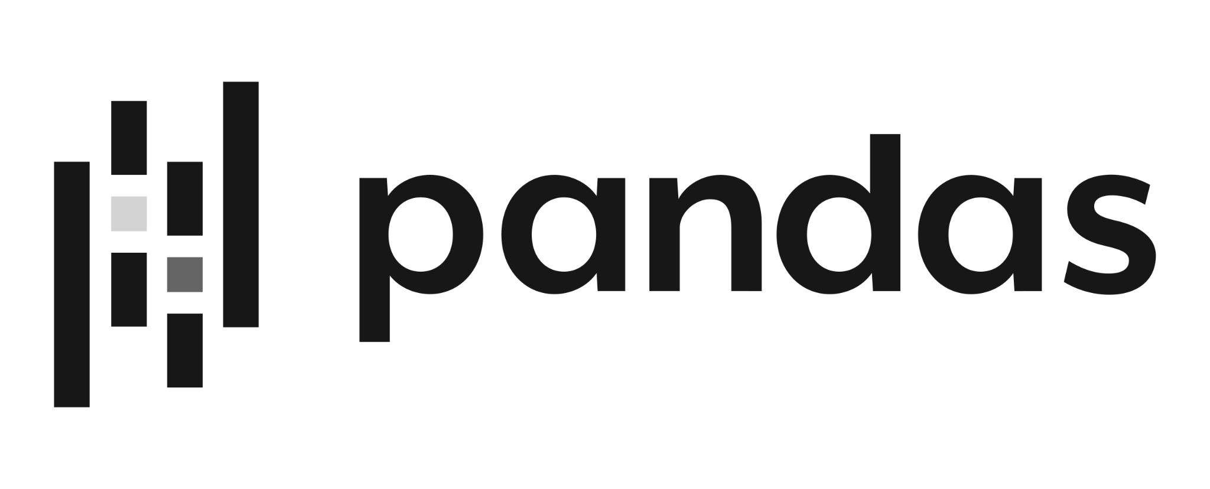

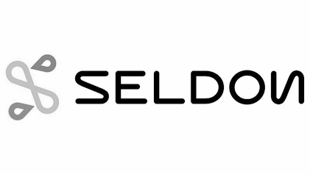







Operations in action
Develop
Optimise
Deploy
Kubernetes
Notes:
Slide 7: Taking a look in action. Key message: Breaking down a Kubeflow deployment, from infrastructure to application and data levels

Slide 10
Long-term vision
Hybrid cloud
from
One cloud
to
Multi cloud
Notes:
Slide 8: Multicloud extrapolation - key message: often, stacks will differ from use case to use case, therefore a multicloud mentality is essential

Slide 11
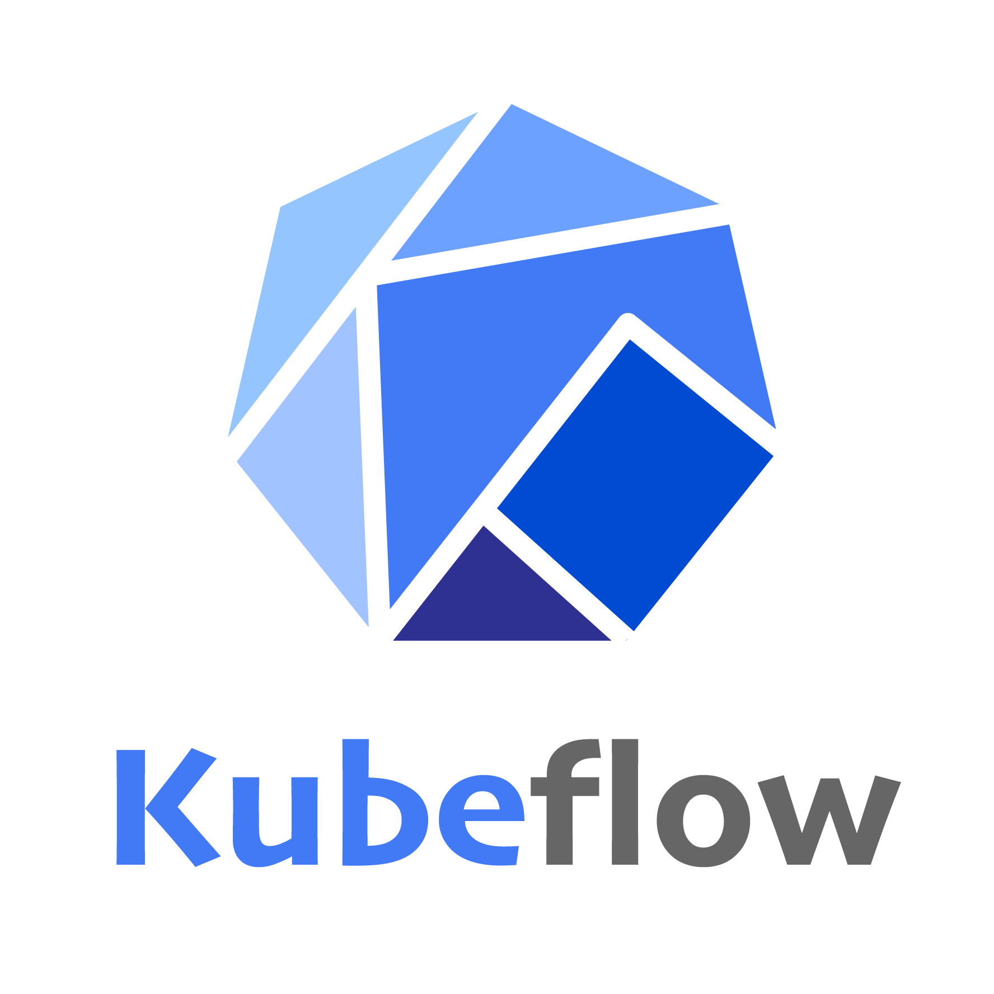







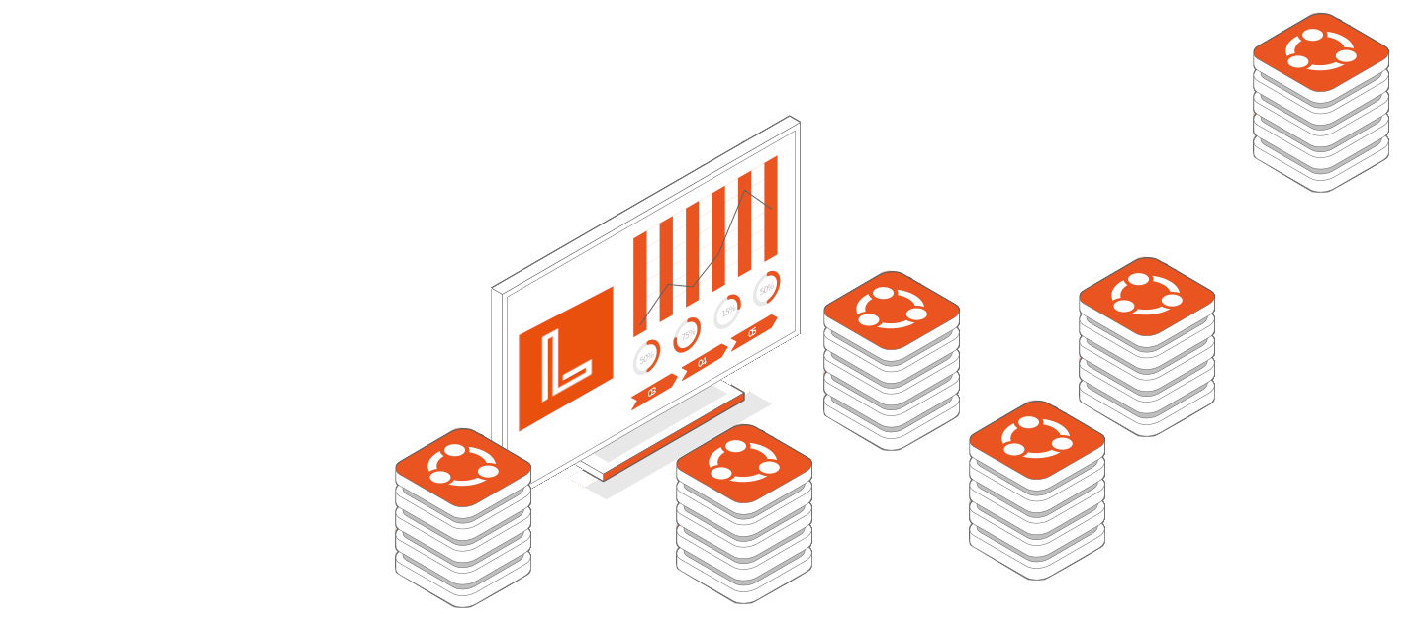
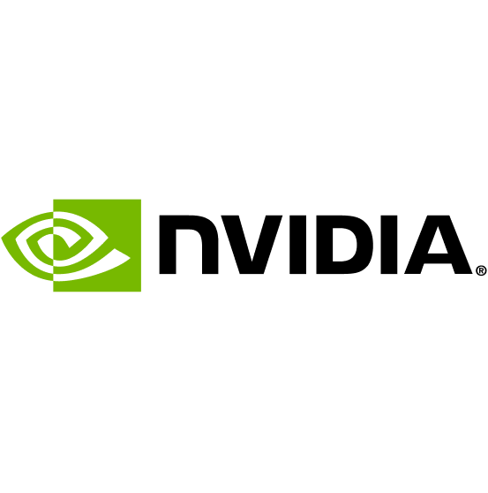







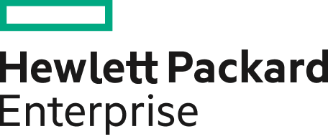




AI operatins: what are the challenges?
APPLICATIONS
LIFECYCLE ORCHESTRATION
CLOUD PLATFORM
STORAGE
INFRASTRUCTURE MANAGEMENT
OPERATING SYSTEM
HARDWARE AUTOMATION
CERTIFIED HARDWARE
Notes:
Slide 9: Operations per component - Key message: each component in itself needs to be updated, monitored, patched, and recovered in times of incidents. But also, the whole stack has different upgrade cadences, so a holistic view is necessary.

Slide 12
Tackling the problem
Point A
Ignore operational detractors
Tackle operational detractors
Self-management
Managed services
Notes:
Slide 10: Tackling operational detractors - key message: companies of any size have only two options when approaching their operational requirements: focus in-house resources or choose a managed service provider

Slide 13

Self management
Innovation
Operations
- Not impossible
- Not too hard*
- Requires allocation of 25-35% of engineering resources to operations
*with the right people

Slide 14
Managed Services
Models & applications
accelerated innovation
Models & applications
Infrastructure & operations
Infrastructure & operations
Your team
Managed service provider (MSP)
Workload
Workload
Notes:
Often when it comes to AI, there is a skill gap on the market.

Slide 15
MS Benefits
Harmonious ecosystem
Accelerated time to market
Hybrid and multicloud approach
Skill gap coverage
Cost Predictability

Slide 16
The right MSP
Essentials
Processes
Commercial viability
Experience
Product coverage
Intuitive pricing
Resources
Proactivity
Post-handover options
Efficiency
Transparency
No lock-in
Notes:
Slide 14: Managed Services Considerations - key message: a provider that covers the entire stack, allows for scalability, provides good SLA’s and does not lock in

Slide 17
When to choose which?
MSP
Self-management
Speed
Confidentiality
Innovation
In-house XP
Growth
Tech-centricism
Notes:
Slide 15: When to choose which? - key message: it’s important to know when it’s better to hire an MSP, depending on values. If you value costs and speed, an MSP is the way forward. If you work with highly confidential workloads, self-management could be a better alternative.

Slide 18
We mind your ops, you mind your business

Slide 19


Thank you! Questions?
Andreea Munteanu
Product Manager, AI/ML
Adrian Matei
Product Manager, Managed Services
Notes:
Conclusion

